Slide 1
Relationships among ocean acidification, Vibrio tubiashii and Crassostrea gigas larvae
Elene Dorfmeier
University of Washington | S A F S
Steven Roberts, Carolyn Friedman
University of Washington
Ralph Elston
AquaTechnics, Inc.
Mark Strom
National Oceanic and Atmospheric Administration (NOAA)
Northwest Fisheries Science Center (NWFSC)

Slide 2
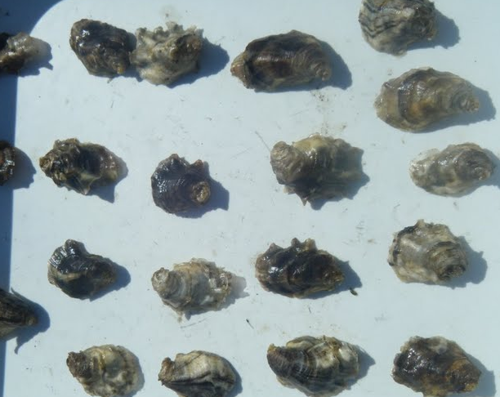
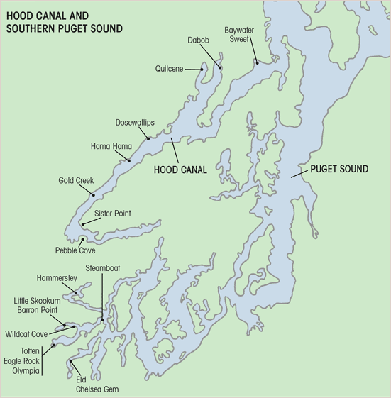
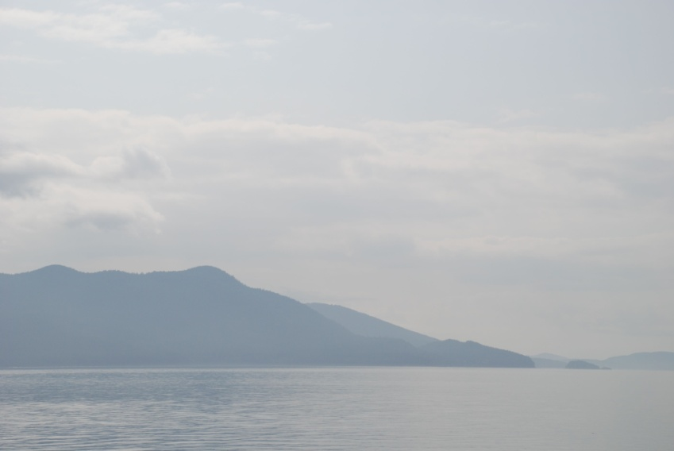
Local Problems for Larvae
Low pH levels in the region
Reduced recruitment and survival
Bacterial disease
Photo by Mackenzie Gavery
Map presented with permission from Rowen Jacobsen

Slide 3

The Big Picture
Use controlled conditions to characterize and measure response of C. gigas and V. tubiashii
    Fertilization, Growth, and Survival
    Pathogen abundance
    Differential gene expressions of pathogen and host
Identify hatchery conditions that are associated with poor larval survival
Water quality and bivalve recruitment analyses
Photo by Mackenzie Gavery

Slide 4
Host
Pathogen
Environment
Disease
Notes:
Big picture

Slide 5
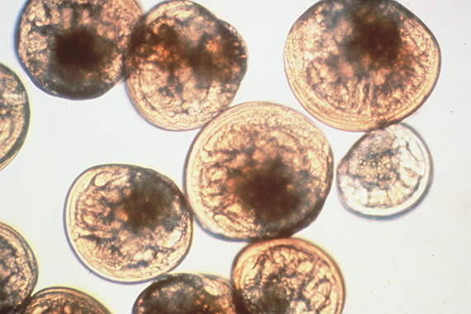
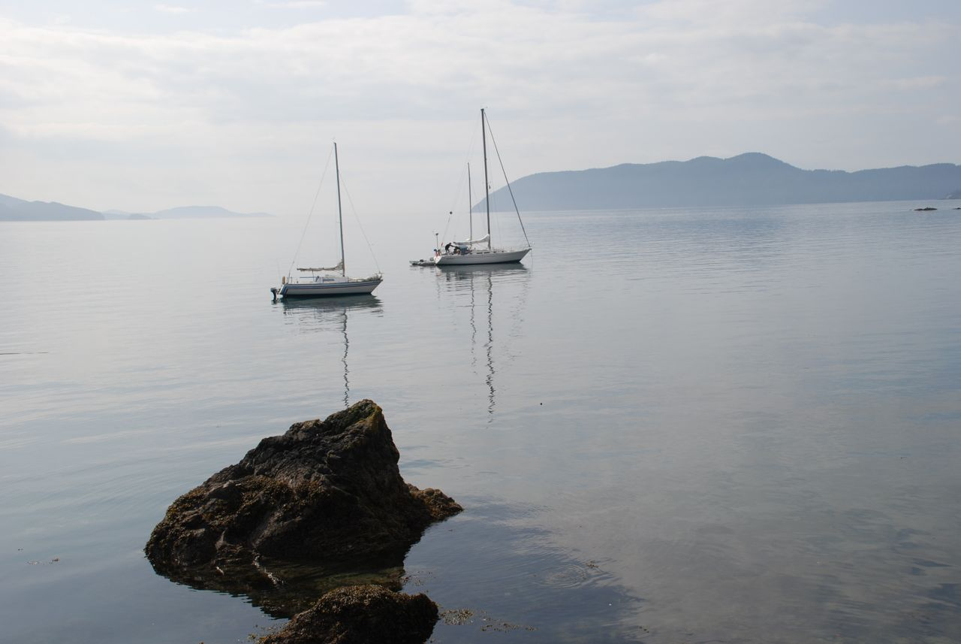
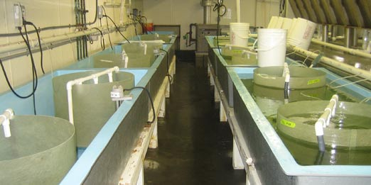
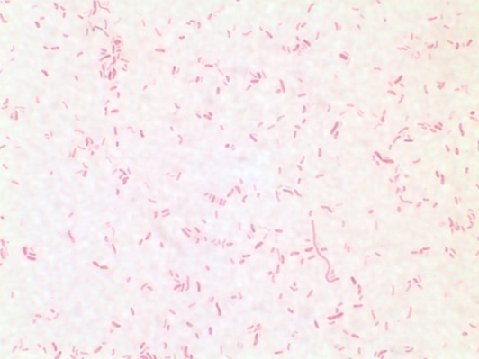
Host
Environment
Pathogen
Larvae photo by Robyn Strenge
Notes:
Larvae + environment

Slide 6

Impact of Acidification on C. gigas
Environment
  Developing embryo and larval stages are suspected to be more sensitive to changes in the environment than are juveniles or adults
      Survival
      Calcification
      Metabolic processes
      Development
      Recruitment
      Disease susceptibility

Slide 7

Response to Environmental Change
Host
      Observed Responses:
        Changes in behavior
        Fertilization and hatching success
        Progression of larval stages
        Ability to tolerate additional stress
        Mortality
Notes:
Any shift in an environment such as pH, temperature, salinity, etc. may be disadvantageous to the host.
Disease may follow any stressful environmental change.
In addition, a combination of two or more factors, for example, high seawater temp and pH, can be much more damaging than one factor alone.
Difficult to separate short term effects from the effects of long term exposure
Physiological Responses:
It is difficult to monitor changes in a host or pathogen in an aquatic environment
But we can track responses at the molecular level
Investigate the cellular level mechanisms in response to environmental change
Gene expression
Pathogenicity and virulence

Slide 8
Response to Environmental Change
Host
      Physiological Responses:
        Metabolism
          Oxygen Consumption
        Immune response to pathogen presence
          Phagocytosis
          Metalloprotease inhibitors

Slide 9
Host
Environment
Pathogen
Larvae photo by Robyn Strenge
Notes:
Larvae + environment

Slide 10

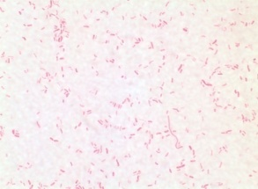
Vibrio tubiashii
Pathogen
Marine bacterium
Pathogenic to a variety of marine invertebrates
Recent epidemics of vibriosis have been correlated with significant mortality in bivalve larvae
  Lack of seed
  Partial closures in local hatcheries

Slide 11
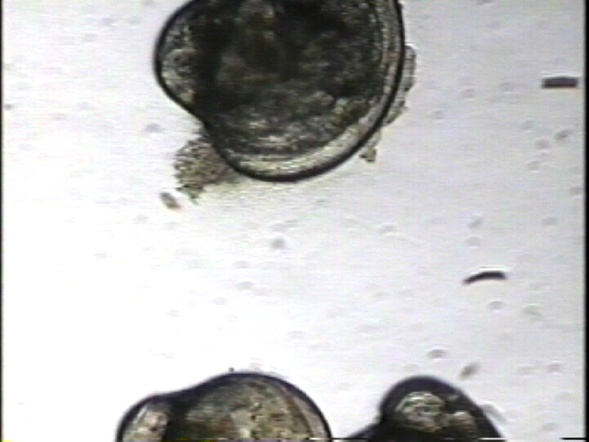
Vibriosis
Pathogen
Opportunistic bacterial infection
Clinical signs include: bacterial swarming around velum, abnormal swimming, inactivity, tissue damage, mortality
Rapid onset of clinical signs can lead to larval mortality of close to 100% within 3-5 days of pathogen exposure
V. tubiashii appears to be highly pathogenic for C. gigas larvae (Estes et al. 2007; Elston et al. 2008)
Photo by Robyn Strenge

Slide 12
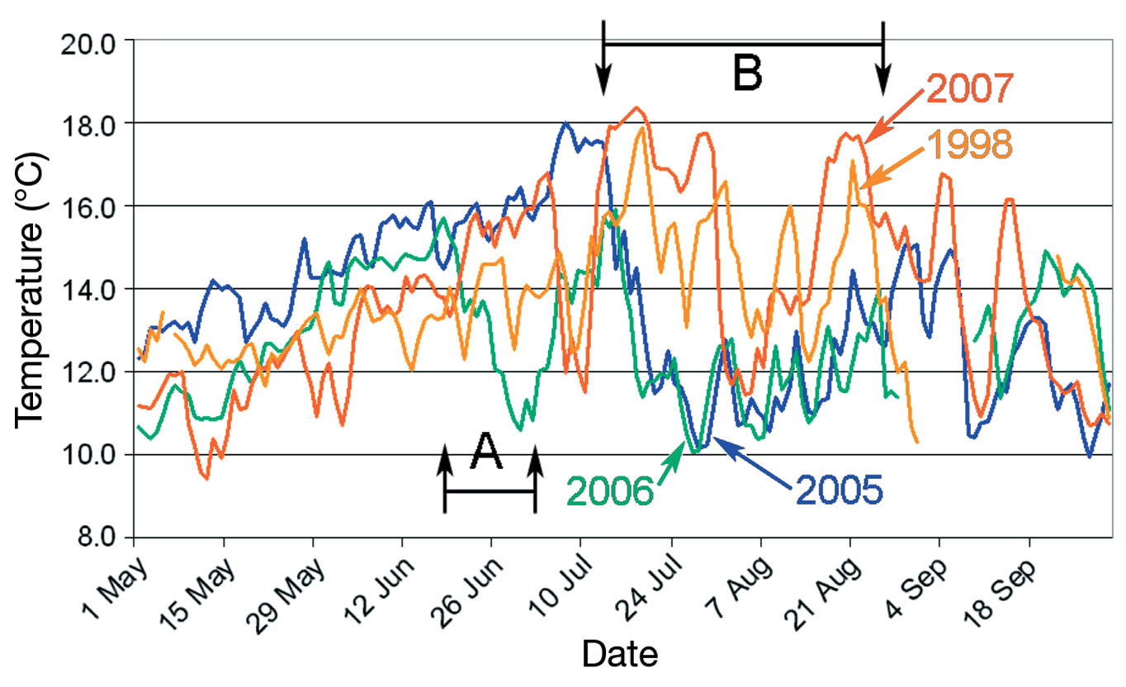
Temperature and V. tubiashii Presence
Environment
Figure from Elston et al. 2008

Slide 13
Preliminary Growth Trial
Environment
Experimental pH Parameter
V. tubiashii growth in adjusted pH (Roberts unpublished)
Notes:
Some prelim V. tubiashii experiments performed by the Roberts Lab at University of Washington.
From past publications (Elston et al. 2008) we know that there’s a clear association with V. tubiashii growth and higher sea surface temperature.
LABORATORY TRIALS AFTER PH RANGE OF BACTERIA
BROAD RANGE TO SEE WHERE V. tubiashii FELL OFF
Top chart:
Tubiashii appears to have greater viability at relatively low pH.
In addition to a relationship with temperature, pH may also influence pathogen survival.
Relative growth of V. tubiashii in media adjusted to range of pHs (Roberts unpublished).
(Y- axis is arbitrary RNA quantity.)

Slide 14
Host
Environment
Pathogen
Larvae photo by Robyn Strenge
Notes:
Larvae + environment

Slide 15
Laboratory Trials
Using controlled experiments to test environmental stressors on the survival, growth and physiology of pathogen and host
Parameters
  pCO₂ levels: 380, 560, 840 and ~2000 ppm
  Temperatures: 10, 14, 18º C
  Time Points: 13 time points from 0 – 72 hrs
  Additional measurements: Salinity, DIC, TA
Notes:
To test the influence of various stressors on survival, growth and physiology of pathogen and/or host.
To test the impact of single and multiple biotic and abiotic stressors on C. gigas larvae we will set up experimental trials.
pH ranges: 6-8
6 medias at 6.0, 6.8, 7.2, 7.4, 7.6, 8.0
temp ranges: 12 – 30 degrees C (3 degree intervals)
time points: 13 time points (0 – 72 hours)
0, 4, 8, 12, 24, 28, 32, 36, 48, 52, 56, 60, 72
We will regulate pH with flow rates of air and CO2 with flowmeters and CO2 monitors.
All trials will be carried out in triplicate 500mL flasks
Trial A:
V. tubiashii with pH and Temp
Looking at growth, survival and gene expression over three days
Pearsons’s moment correlation (r) to test for linear relationship between gene expression, growth rate, survival and envir condition (pH/temp – single and multifactorial)
ANOVA will be used to assess differences in growth among treatments
Trial B:
C. gigas larvae with pH and Temp (different life stages - D hinge, veliger and pediveliger)
Looking at differences in growth and survival
Pearson’s moment correlation for linear relationships between gene expression, growth rate, survival and environmental condition (pH/temp – single and multifactorial
Kaplan-Meier metod and log-rank test (S-Plus) used to assess survival
Diff in growth will be assessed using ANOVA
Trial C:
C. gigas larvae pH and Temp (prolonged exposure to acidic envir)
Spawned in pH 7.6 and 8.0 (control)
Strip spawned and released into 2 pH levels
Trial groups grown at 12, 18 and 25 degrees (summer upwelling, summer maxima, and ideal hatchery larval temps)
Growth. mortality, and abnormal behavior noted
pH tested every 12 hrs
water changed every 24 hrs
Kaplan-Meier method, log-rank test (S-Plus), ANOVA, Pearson’s moment correlation
Trial D:
C. gigas larvae, pH, Temp, and V. tubiashii
To identify the combined effects of multiple stressors larvae will be cultured with manipulated pH, V. tubiashii exposure and temp
pH of 7.6 and 8.0
12-30 degrees C
3 x 10^4 to 3 x 10^5 CFU/ml
every 24 and 96 hrs
water change daily
Pearson’s moment correlation
Trial E:
C. gigas larvae, pH, temp and OsHV
Same conditions as in Trial D
Trial F:
C. gigas larvae, pH, temp, V. tubiashii and OsHV
Multiple pathogen experiment
Two temps: 18 and 25 degrees – double check
pH will not be altered (8.0)
larval growth and survial, gene analysis
Selected samples in each trial will be used for gene expression analysis

Slide 16
Trial A
Vt
V. tubiashii growth at various pCO₂and temperature ranges
      Growth, survival and gene expression
      Trial period: 3 days
      Full range of pCO₂ and temperature
Notes:
In media and in seawater

Slide 17
Trial B
C. gigas larvae at various pCO₂ and temperature ranges
      Multiple life stages (D-hinge, veliger, pediveliger)
      Differences in growth, morphology and survival
      Trial period: 3 days
      Full range of pCO₂ and temperature
Cg

Slide 18
Trial C
Prolonged exposure of C. gigas to acidic conditions
      Strip-spawned
      Differences in fertilization, growth, behavior, morphology and survival
      pCO₂ levels: 380 and ~2000 ppm
      Temperatures: 10, 14, 18º C
Cg
Cg
Illustration source: FAO

Slide 19
Trial D
Bacterial challenge at varying pCO₂ levels
      C. gigas and V. tubiashii
      Gene expression of pathogen and host
      Larval survival and morphology
      pCO₂ levels: 380, 560, 840, ~2000 ppm
      Temperature: 18º C
Cg
Vt

Slide 20
Study Objectives
  Test the influence of environmental stress on the survival, growth and physiology of the pathogen and host
  Identify the effects of multiple environmental stressors on C. gigas larvae
  Characterize C. gigas response in relation to pathogen physiology
  Correlate experimental trials with environmental sampling

Slide 21
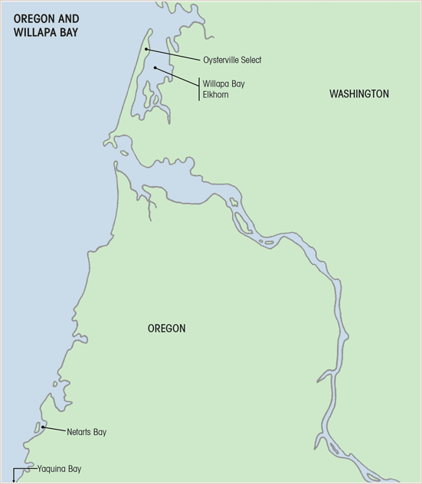
Taylor and Whiskey Creek Hatcheries and Bay Center Mariculture
Maps presented with permission from Rowen Jacobsen
Notes:
We will enumerate Vibrio tubiashii associated with zooplankton, phytoplankton, and flocculent material and quantify pathogen levels in areas surrounding the hatcheries.

Slide 22
Anticipated Results
        C. gigas:
        Slower progression through life stages
        Poor metabolic activity
        Increase disease susceptibility
        Lower fertilization, hatching and survival rates
        Shell dissolution at highest levels of pCO₂
        V. tubiashii:
        Disease expression enhanced
        Increase in abundance

Slide 23
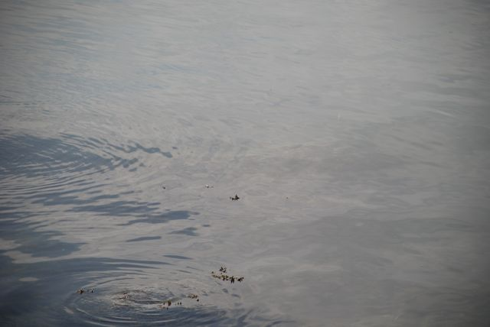
Acknowledgements
Saltonstall-Kennedy Program of NOAA
University of Washington: School of Aquatic and Fishery Sciences
UW Roberts Lab | UW Friedman Lab
NOAA - NWFSC
National Shellfisheries Association, Pacific Coast Section
Pacific Coast Shellfish Growers Association
Richard Wilson – Bay Center Mariculture
Russell Rogers - WDFW
Joth Davis - Taylor Resources, Inc.
Sue Cudd - Whiskey Creek Shellfish Hatchery, LLC

Slide 24
Questions?

